Slide 1
Agenda:
Why Delta Lake?
Transaction Logs
How Delta Table is Created
DML Operations
Checkpoints
VACUUM - Garbage Collection
Time Travel
Optimistic Concurrency Control

Slide 2
Why Delta Lake?
Delta Lake is an opensource project that enables building a Lakehouse architecture on top of data lakes.
Issues with Traditional data Lakes:
No ACID Transactions
Cannot Handle Updates/Deletes
Schema Evolution Problems
No Time Travel
Small File Problem
Concurrent Writes
Delta Lake Solution:
Transaction Log provides atomic commits
Copy-on-Write with versioned files
Metadata tracking in transaction log
Version history preserved in logs
Auto-optimization and compaction
Optimistic Concurrency Control

Slide 3
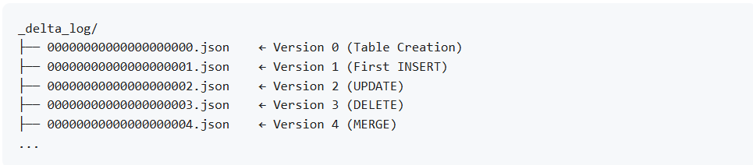
Transaction Logs:
Delta Table
Data Files (Actual Data)
Delta Log (Transaction Log / Metadata / Versioning)
The transaction log is a sequentially numbered series of JSON files that records every transaction made to the Delta table.
Actions:
Protocol
Metadata
Add (File Addition)
Remove (File Removal)
Commit Info

Slide 4
How Delta Table is Created:
S
Transaction Log Creation
Data File Creation
Statistics
collection
Final state
DML Operations:
Insert
Update
DML
Delete
Merge

Slide 5
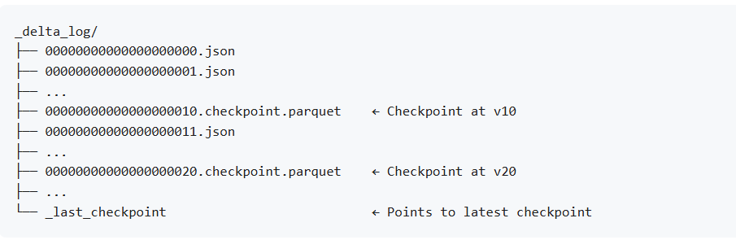
Check Points:
A checkpoint is a snapshot of the table state at a specific version, saved in Parquet format.
A checkpoint contains all active "add" actions at that version.
By default, for every 10 commits a checkpoint is automatically created.
_last_checkpoint File

Slide 6
Vacuum:
VACUUM physically deletes files that are
No longer in the current version
Older than the retention threshold
Default Retention 7 days (168 hours)
Statistics Collection
Identify Candidates for Deletion
Identify Active Files
List All Physical Files
Delete Files
Vacuum logs:
Vacuum does NOT change table version for data operations
It records cleanup operations
Doesn't affect current state reconstruction
Purely for audit purposes

Slide 7
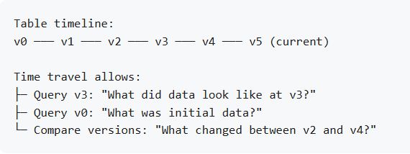
Time Travel:
Ability to query historical versions of the table.
Use cases:
Auditing
Debugging
DA/B Testing
Data Recovery
Regulatory Compliance
Syntax:
-- By version number
SELECT * FROM table_name VERSION AS OF 3
-- By timestamp
SELECT * FROM table_name TIMESTAMP AS OF '2024-01-05'
-- DataFrame API
spark.read.format("delta").option("versionAsOf", 3).load("/path")
Time Travel Limitations
VACUUM affects time travel
Transaction log retention
Performance

Slide 8
Optimistic Concurrency Control:
Pessimistic (traditional databases) | Optimistic (Delta Lake)
Acquire lock before reading | No locks during read/modify
Hold lock during modification | Writers work in parallel
Release lock after commit | Check for conflicts at commit
Other writers wait (serialized) | Conflicts are rare, so this is faster
Conflict Resolution
Delta Lake checks for two types of conflicts:
Disjoint Transactions (No Conflict)
Overlapping Transactions (Conflict)
Isolation Levels
Serializable (Default)
WriteSerializable
Snapshot Isolation

